Slide 1
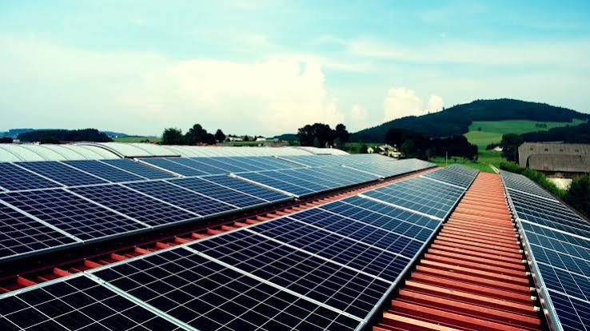
SDG 7 · AFFORDABLE & CLEAN ENERGY
SolarSense AI
AI-Powered Rooftop Solar Advisory and Lead Generation Platform

Slide 2

PROBLEM
Rooftop Solar Adoption is Still Complicated
Despite growing awareness, the path from interest to installation remains fragmented and opaque for most homeowners.
Knowledge Gap
Sizing Uncertainty
Unrealistic Tools
Multiple Consultations
Most homeowners lack technical knowledge about rooftop solar systems and components.
Customers do not know how much solar capacity they actually need for their home.
Existing calculators ignore roof limitations and often provide impractical recommendations.
Obtaining quotations requires several site visits and consultations with different vendors.
Financial Opacity
Trust Deficit
Customers struggle to estimate installation cost, savings and return on investment.
Finding trusted, verified solar installers remains a significant challenge.
This uncertainty slows the adoption of clean energy.

Slide 3


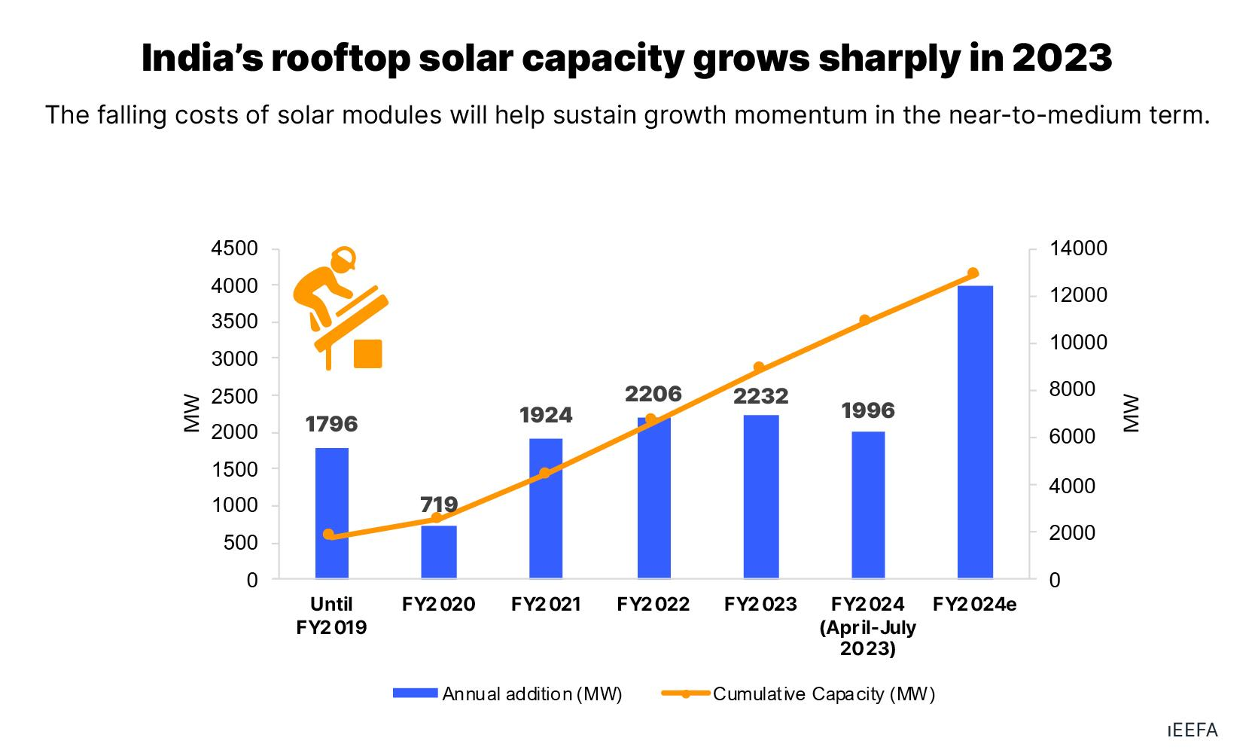




MARKET OPPORTUNITY
A Growing Market Needs Intelligent Automation
India's renewable energy sector is growing rapidly, driven by ambitious national targets and increasing environmental awareness.
Rooftop solar adoption is expected to increase significantly in the coming years as technology costs decline and policies mature.
Millions of residential customers require personalised solar guidance tailored to their unique consumption and roof profiles.
Solar companies spend considerable effort and capital acquiring qualified customer leads, creating a clear B2B opportunity.
Rapid Sector Growth
India's renewable energy sector is expanding at pace.
Rooftop Surge
Rooftop solar adoption is expected to rise significantly.
Mass Market Need
Millions of residential customers need personalised guidance.
Lead Acquisition Cost
Solar companies spend heavily to acquire qualified leads.
The market requires an intelligent and automated advisory solution.

Slide 4
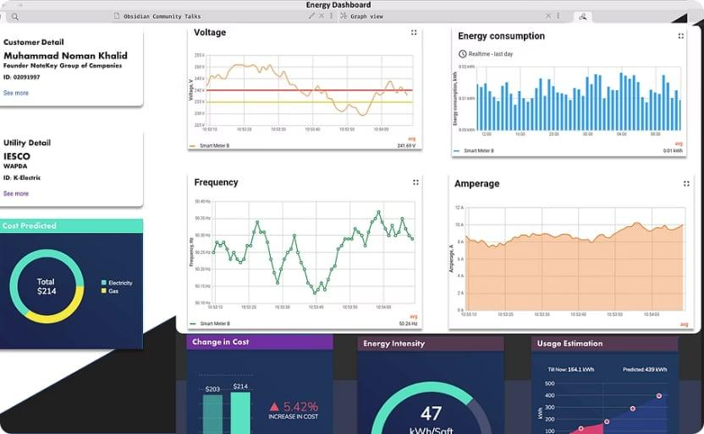
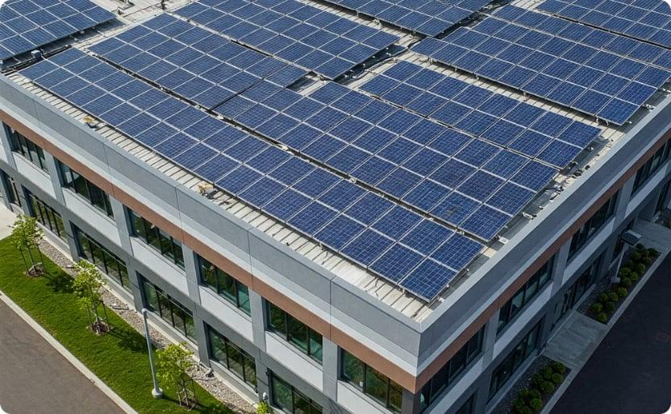
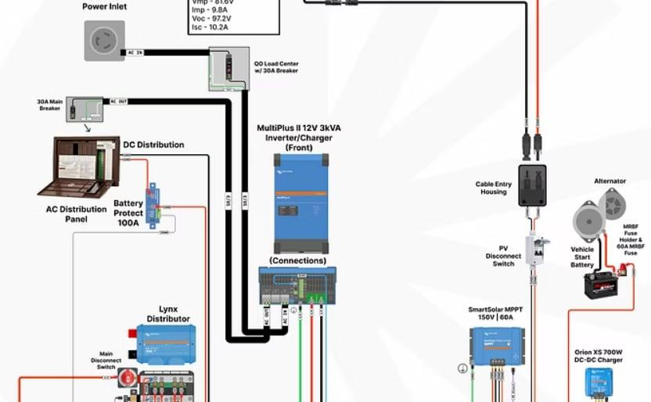

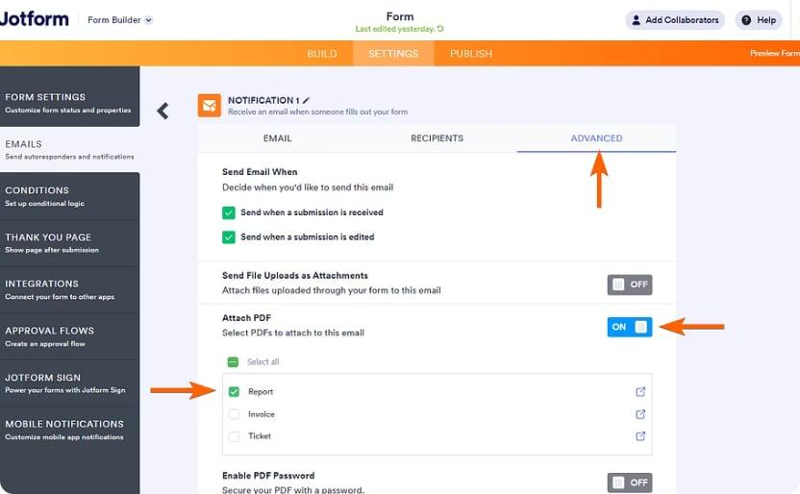
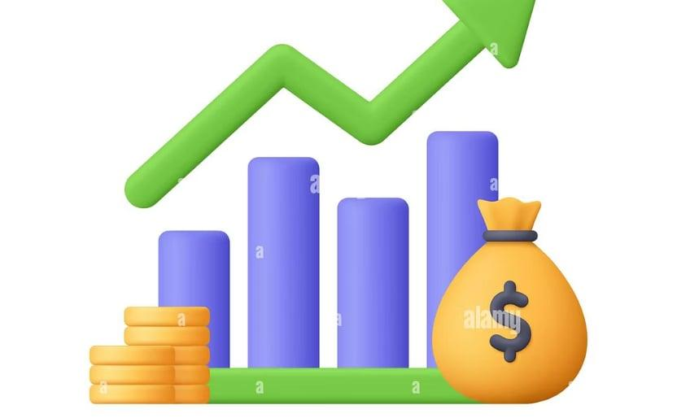
SOLUTION
Introducing SolarSense AI
An AI-powered platform that simplifies rooftop solar adoption by delivering instant, personalised and actionable guidance directly to homeowners.
Consumption Analysis
Roof Feasibility
Optimal Sizing
Analyzes customer electricity consumption patterns.
Evaluates roof feasibility and structural constraints.
Calculates optimal solar system size for the household.
Installer Matching
Report Delivery
Cost & Savings
Recommends trusted and verified solar installers.
Generates professional PDF reports and delivers via email.
Estimates installation cost, savings and return on investment.

Slide 5
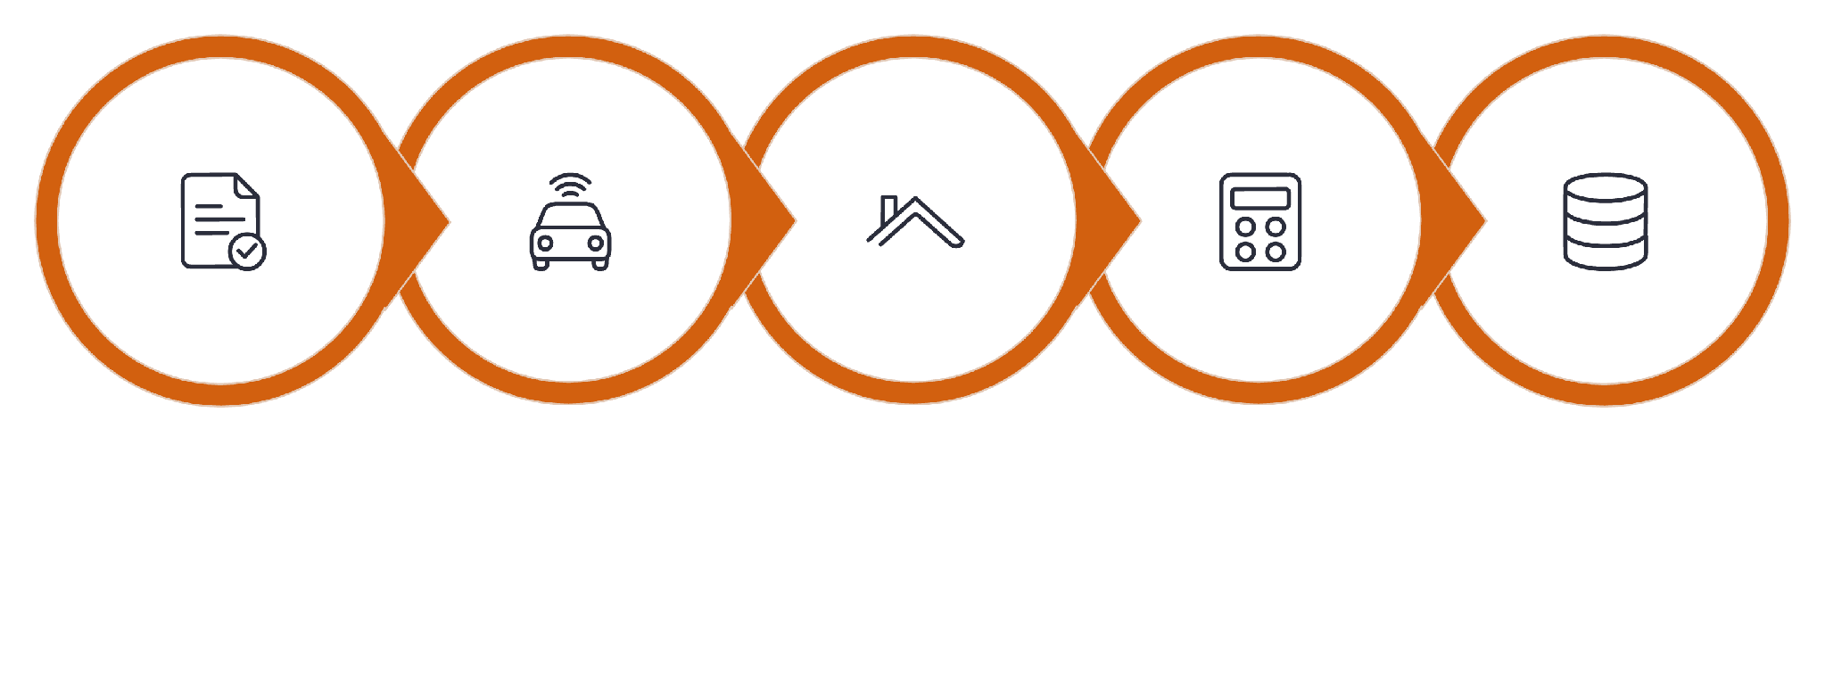
WORKFLOW
How SolarSense AI Works
Customer Input
AI Analysis
Roof Check
Financials
Lead Storage
From customer input to delivered report, the entire workflow is fully automated — eliminating manual intervention and reducing advisory time from days to seconds.

Slide 6

ARCHITECTURE
Technology Architecture
Technology Stack
HTML — Markup structure
CSS — Styling and layout
JavaScript — Client-side logic
n8n — Workflow automation engine
Google Gemini — AI analysis and reasoning
PDFMonkey — Automated report generation
Gmail API — Email delivery integration
Google Sheets — Lead database storage
Netlify — Frontend hosting and deployment
Railway — Backend workflow hosting
Frontend
Workflow
AI
Database

Slide 7







FEATURES
Core Features
AI-based Solar Sizing
Roof Feasibility Analysis
ROI & Savings Calculation
Intelligent system sizing based on consumption patterns and roof constraints.
Evaluates roof parameters to determine practical installation viability.
Projects installation costs, long-term savings and payback periods.
Installer Recommendations
Automated PDF Reports
Email Delivery
Generates professional, personalised advisory reports automatically.
Delivers reports directly to customers via Gmail integration.
Connects customers with trusted, verified solar installation partners.
Lead Management System
Stores and organises customer leads in Google Sheets for follow-up.

Slide 8
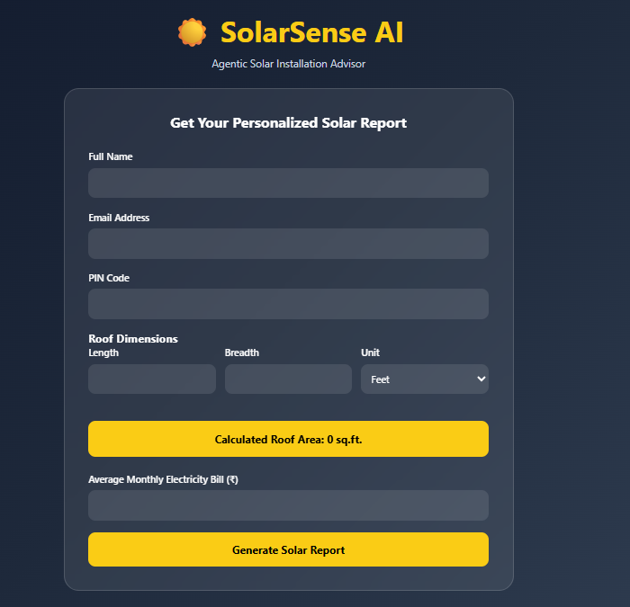
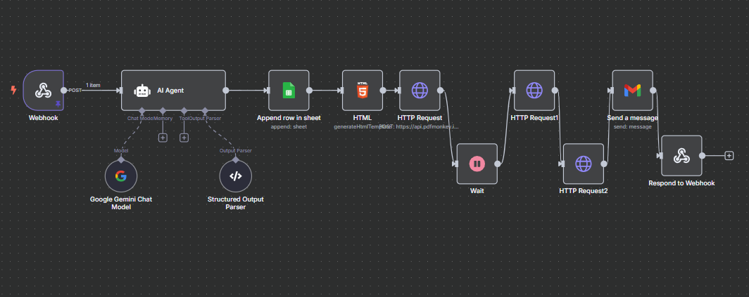
DEMONSTRATION
Live Product Output
The following screenshots demonstrate the end-to-end customer journey — from initial input through AI analysis to final report delivery and lead capture.
Customer Input Form
AI Recommendation Page
Homeowners enter consumption and roof details.
System displays optimal sizing and savings analysis.

Slide 9
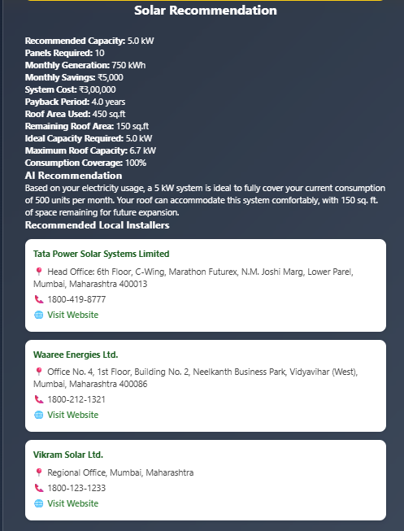
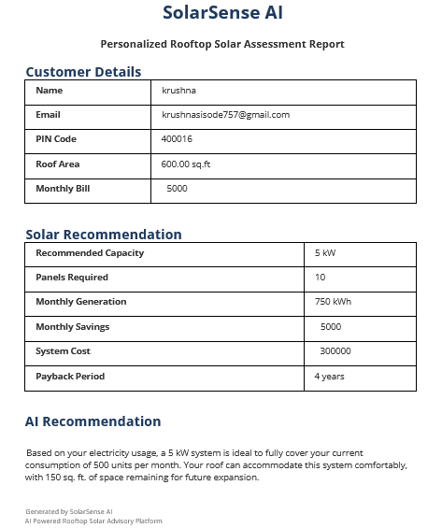
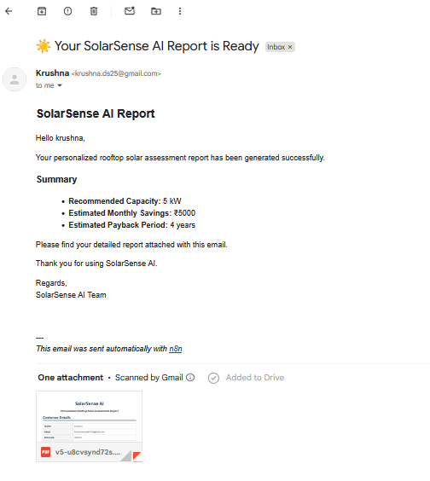
DEMONSTRATION
Live Product Output
The following screenshots demonstrate the end-to-end customer journey — from initial input through AI analysis to final report delivery and lead capture.
AI Recommendation Page
Generated PDF Report
Email with Attachment
System displays optimal sizing and savings analysis.
Professional advisory report ready for download.
Report delivered directly to the customer's inbox.

Slide 10

IMPACT
Value Created for Every Stakeholder
For Customers
For Solar Installers
For Society
Instant, personalised recommendations
Significantly reduced consultation time
Better-informed investment decisions
Steady stream of qualified customer leads
Reduced customer acquisition costs
Improved conversion through informed buyers
Increased renewable energy adoption
Support for sustainable development goals
Accelerated path to a cleaner energy future

Slide 11


FUTURE VISION
Accelerating Solar Adoption Through AI
Government Subsidy Estimation
Carbon Footprint Analysis
Satellite Roof Assessment
Quantify environmental impact and CO₂ reduction per installation.
Use satellite imagery for automated roof mapping and shading analysis.
Integrate live subsidy schemes to refine net cost projections.
Customer Analytics Dashboard
Real-time Installer Discovery
Match customers with available installers based on location and capacity.
Provide installers with insights into lead quality and conversion trends.
SolarSense AI transforms a complex and technical process into an intelligent, automated and customer-friendly experience.
Thank You
Questions?
GitHub Repository: krushnads25/SolarSense-AI

